Slide 1
Design Compiler For Synthesis
王沛卓

Slide 2
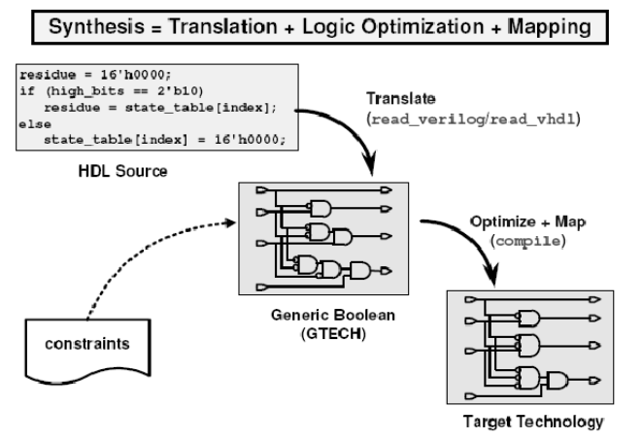
What is synthesis？

Slide 3
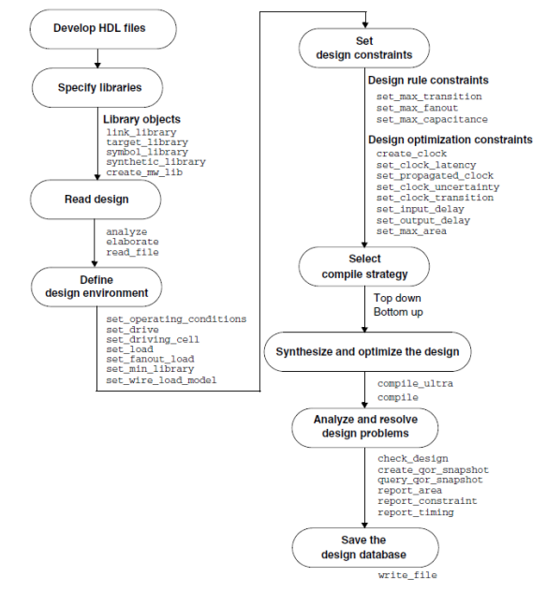
Synthesis flow

Slide 4
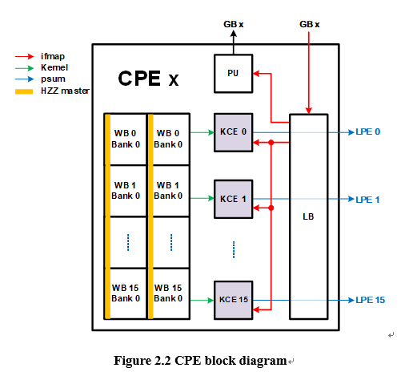
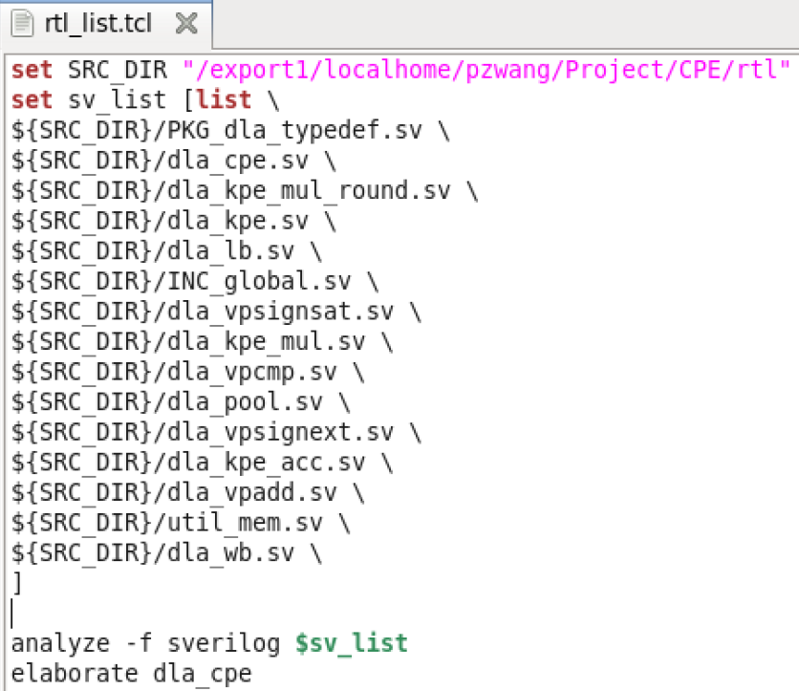
Develop HDL Files

Slide 5
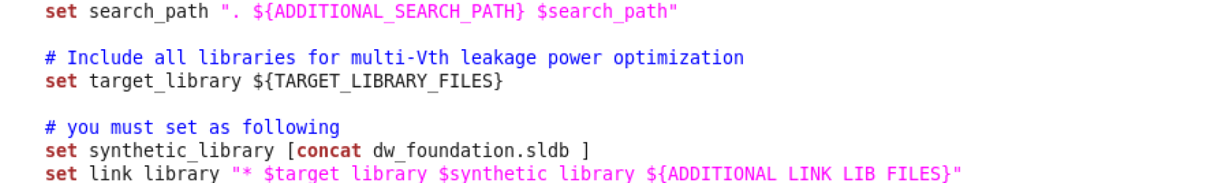
Specify libraries
Technology library(link_library & target_library )
Symbol library
Synthetic library(IP library)

Slide 6
Define Design Environment
PVT
I/O ports property(load , drive , fanout)
Wire-load module

Slide 7
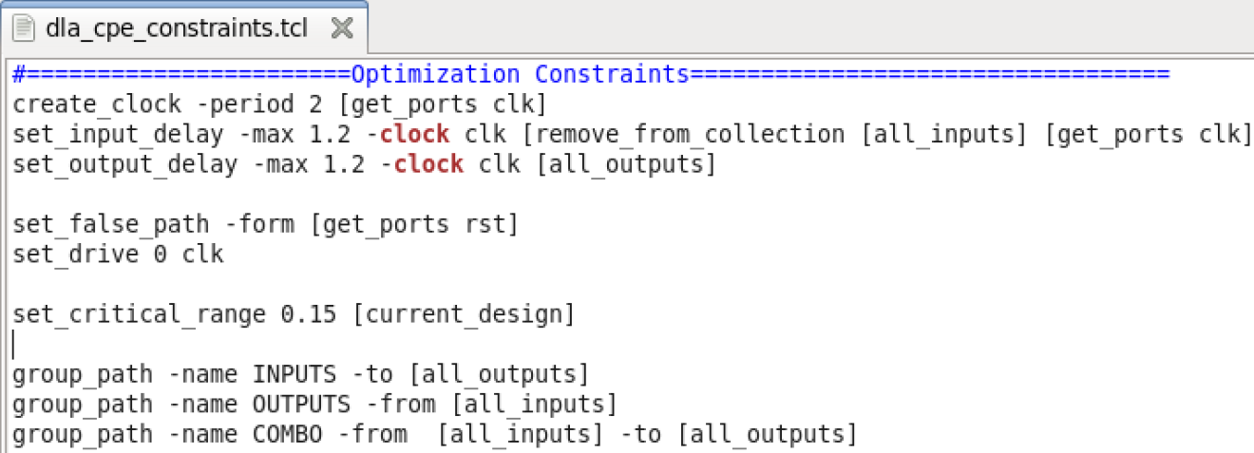
Set Design Constraints
Design Rule Constraints
Defined by technology library, must be metset
Optimization Constraints
Timing
create _clock set_input_delay set_output_delay
Area(DC Export Only)
set_max_area

Slide 8
Select Compile Strategy
Bottom up
Top down

Slide 9
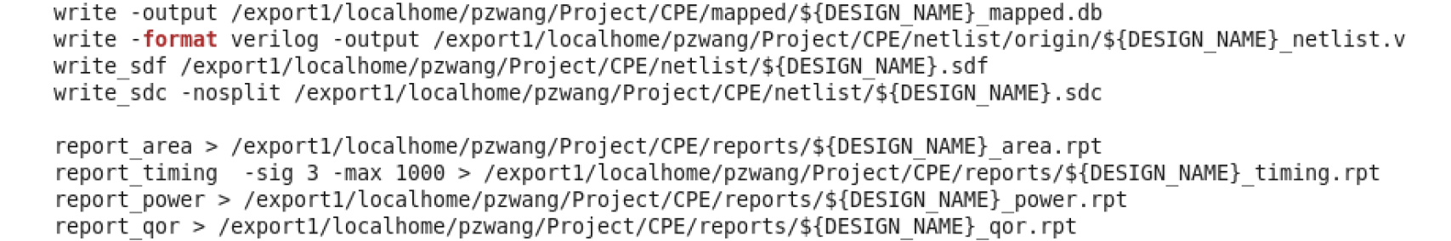
Analysis & Resolve Problems
Write
Report

Slide 10
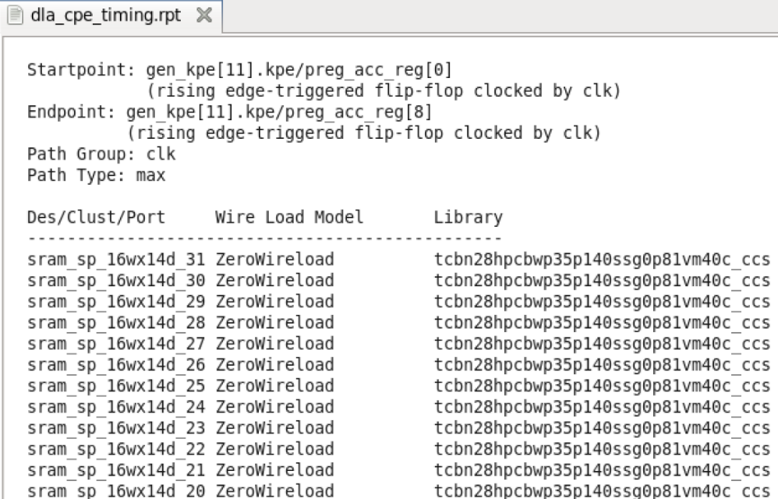
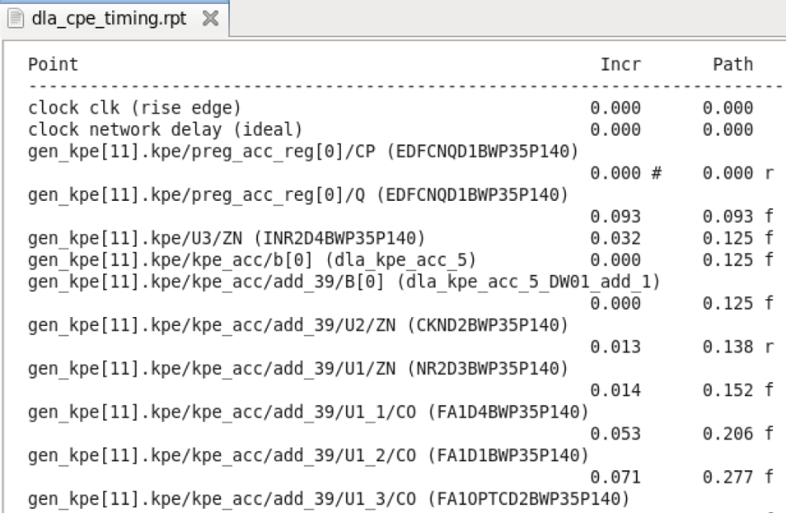
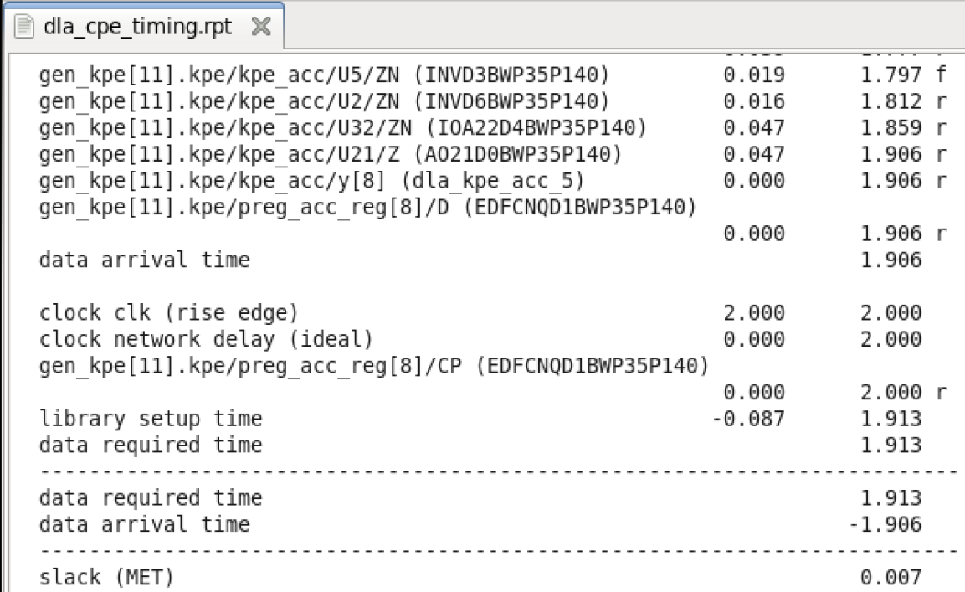
Timing_Reports

Slide 11
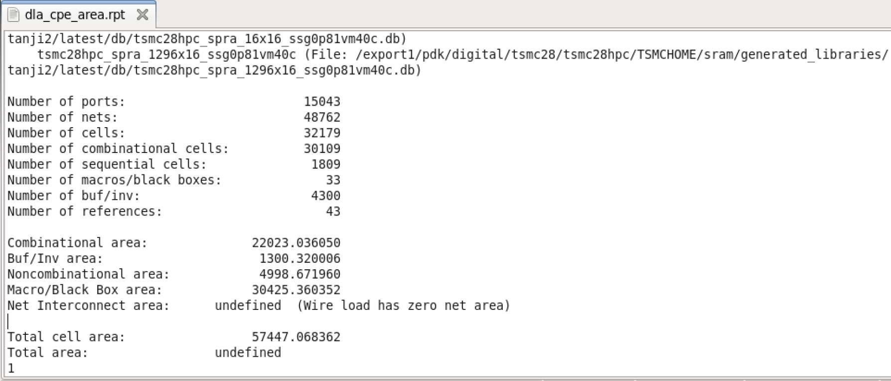
Area_Reports

Slide 12
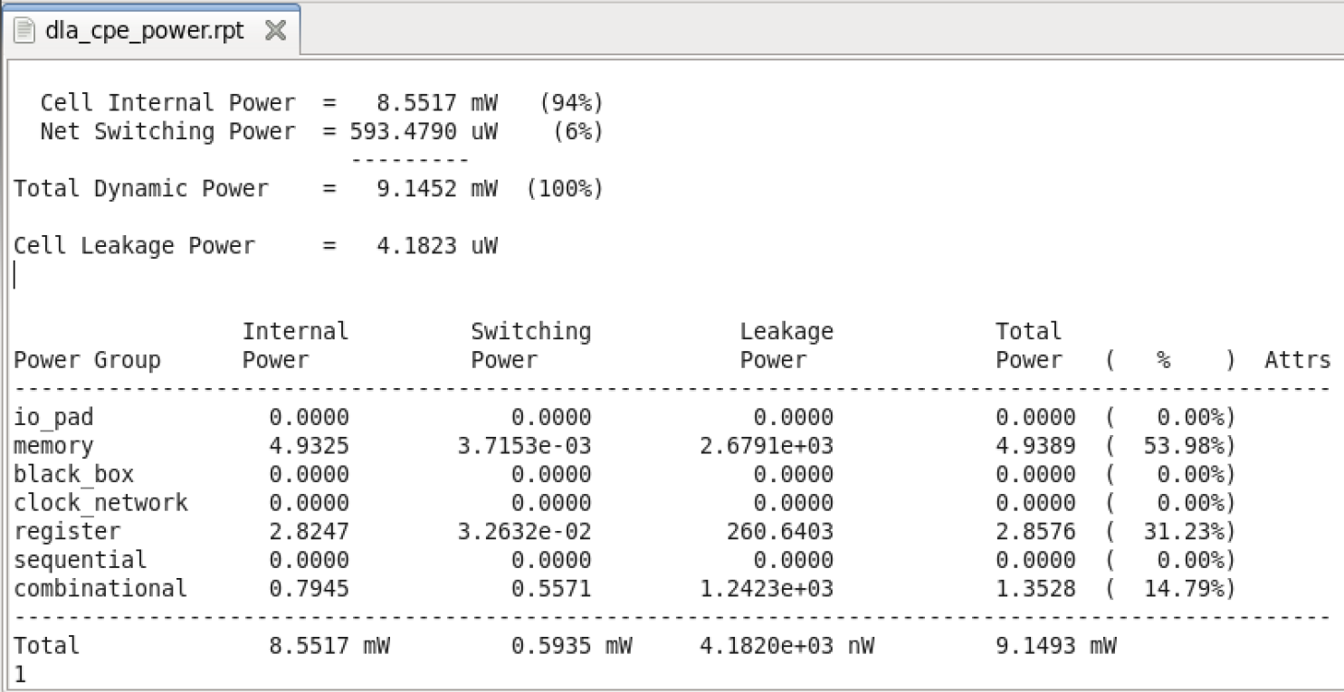
Power_Reports

Slide 13
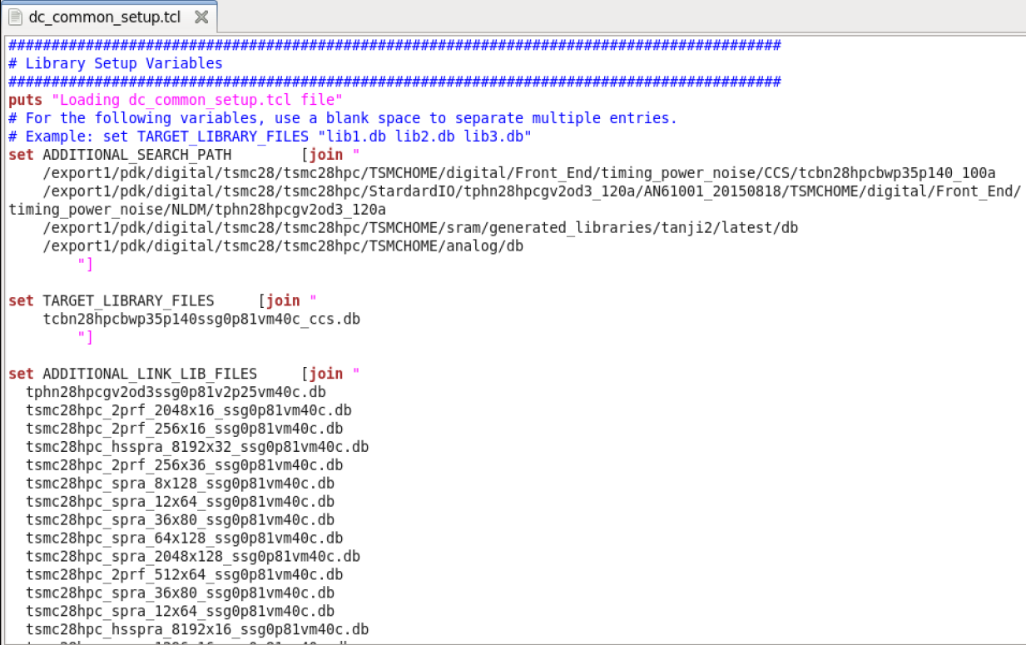
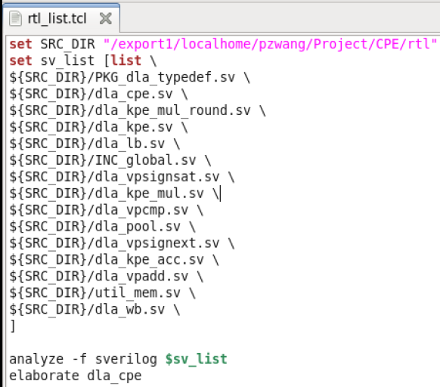
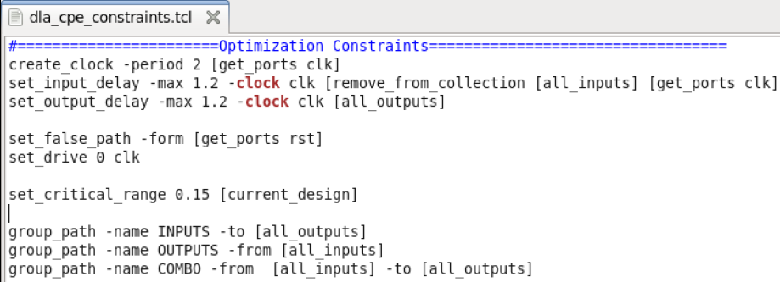
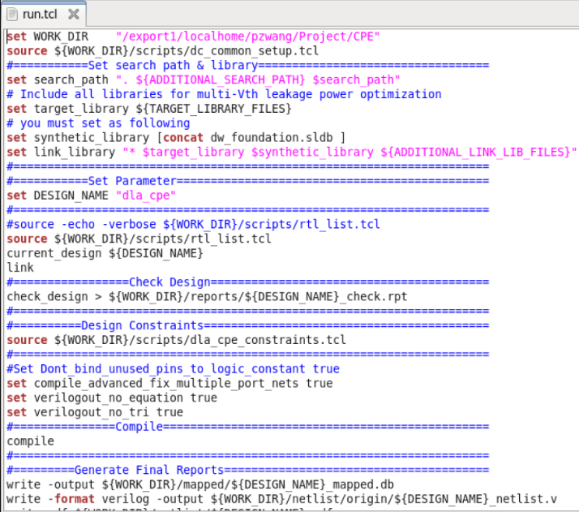

Slide 14
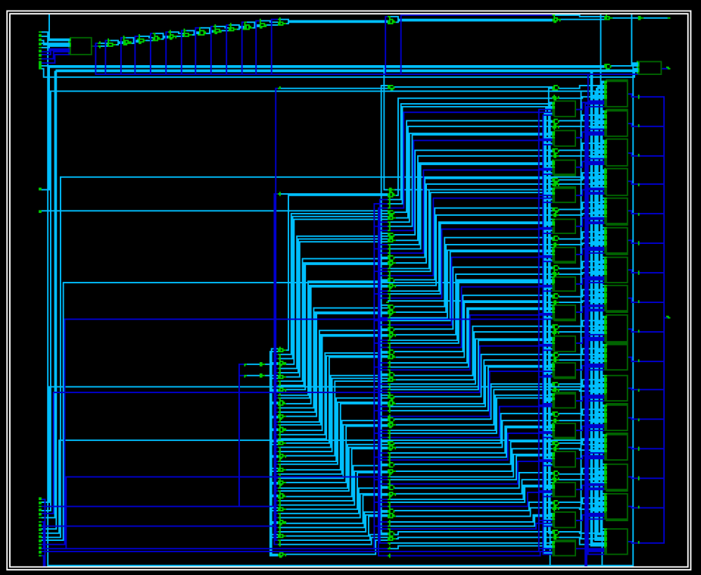
Schematic

Slide 15
